Slide 1
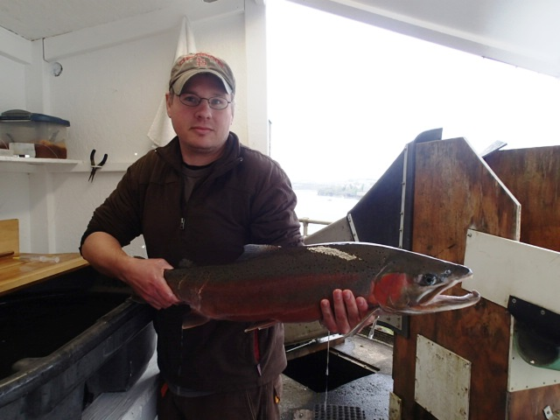

Migration Behavior and Distribution of Winter and Summer Steelhead Radio-tagged at Willamette Falls Dam 2012-2014
C. Erdman, M. Keefer, C. Caudill, M. Jepson, T. Blubaugh, S. Lee, M. Knoff, M. Morasch, and C. Sharpe¹
Department of Fish and Wildlife Sciences
University of Idaho, Moscow, ID 83844-3141
¹Oregon Department of Fish and Wildlife
Notes:
Thank you Brad for the introduction
I am going to present results from two separate studies we conducted in the basin from 2012 through 2014

Slide 2
Radio-Tagged Steelhead at Willamette Falls
Describe steelhead behaviors in mainstem and tributaries:
Tributary escapement
Kelting behavior
Repeat spawning (iteroparity)
Spatial and temporal overlap of winter and summer steelhead
Radio-Tagged Recycled Summer Steelhead
Fate of recycled summer steelhead
Notes:
The main portion of the presentation will focus on results from a adult winter and summer steelhead tagging effort at Willamette Falls Dam during the three study years.
The main goal was to …
Results from the second project will be towards the end of the presentation. This project involved radio-tagging adult summer steelhead at Foster and Dexter Dams and then recycling these fish in the S Santiam and the Middle Fork Willammette

Slide 3
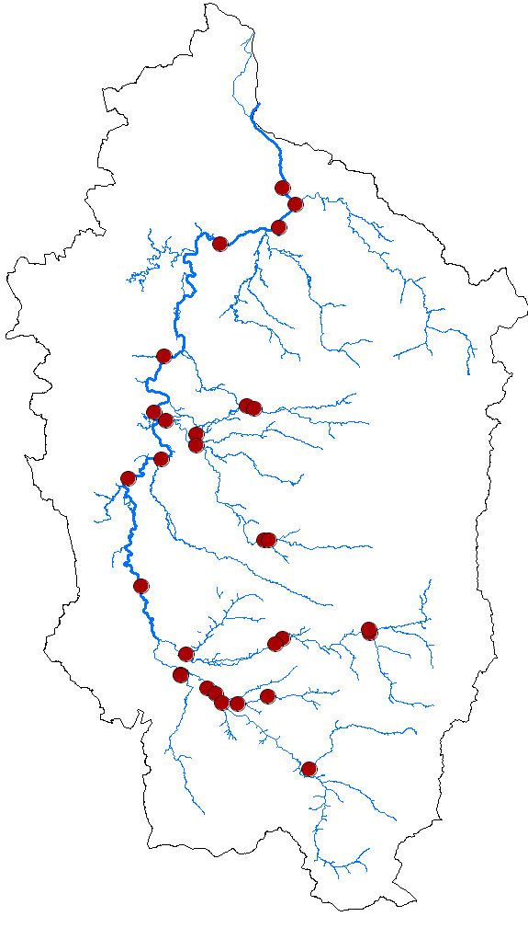
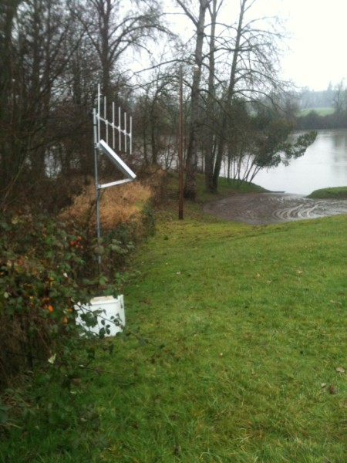
Fixed-site Monitoring
WFD
CLK
WL1
WFU
WL2
WL3
N. Santiam R.
WL4
CAL
S. Santiam R.
WL5
McKenzie R.
CFW
Fall Creek
Middle Fork
Notes:
Not going to go into describing the methods as they were exactly the same as the methods Matt described in his first talk this morning.
To monitor the movements of steelhead, fixed radio-telemetry sites were located throughout the basin
At least 40 sites were used each year during the study

Slide 4
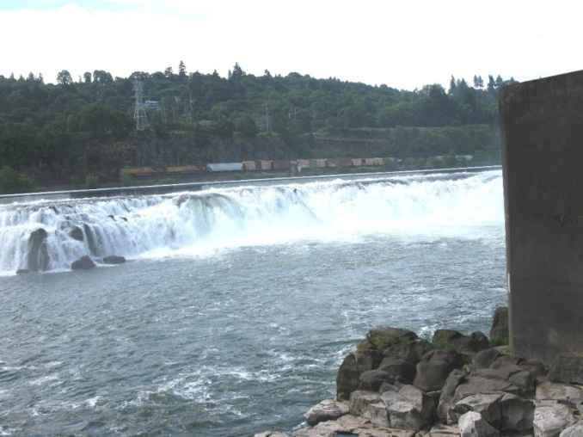
Results - Environmental Data
USGS 14174000 WILLAMETTE RIVER AT ALBANY, OR
Data source = http://ida.water.usgs.gov/
Notes:
As the figures show there were varying environmental conditions among the three study years
These data are from the Willamette River USGS gauge in Albany
On the left are temperature data and on the right are flow data from the three study years
As the figures show, the three study years covered a range of environmental conditions
Low temperatures and high flows in 2012. Low flows and higher temperatures in 2013

Slide 5
Steelhead Run Sizes
Notes:
Run sizes of steelhead counted passing Willamette Falls down were above the ten-year average in 2014 and 2012
Counts were well below the 10 year average in 2013, mostly a result of lower summer steelhead passing the falls

Slide 6
Winter Steelhead Tags and Counts
Notes:
This figure shows the number of winter steelhead tagged each year
On the x axis we have date, on the left y axis we have the count of steelhead at Willamette Falls, and on the right y axis we have the quantity of tagged steelhead
A maximum of 4.0% of the run was tagged annually
In 2014, we began tagging winter steelhead in November, in an effort to understand the behavior of these early-run winter steelhead
ENLARGE FONT

Slide 7
Run Timing – Winter Steelhead
Notes:
The run timing of winter steelhead is pretty variable, with the median run date generally occurring at the end of February through the month of March

Slide 8
Winter Steelhead Escapement to Tributaries 2012-2014
Highest returns:
Santiam
Molalla
Middle Fork
Range = 81-84%
Mean = 83%
Notes:
Drainage on horizontal axis and mean % of sample for three years on the vertical axis.
Errors bars represent 1 standard deviation
Max returns to the Santiam, Molalla, and Middle Fork.
CHANGE COLOR

Slide 9
Fates of early-run winter steelhead
Highest returns to Santiam & Molalla
Kelts = 29% (all tagged)
Kelts = 56% (escaping to tribs.)
~50% did not escape to a tributary
Notes:
As I mentioned earlier, we initiated tagging earlier during the last year of the study
Looking solely at winter steelhead tagged from November 2013 through February 2014, approximately 50% did not escape to a tributary, which is much different from what we saw on the previous slide
The Mollala and the Santiams had the highest returns
29% of all fished tagged during this period displayed kelting behavior and 56% of the fish that escaped to tributaries displayed kelting behavior

Slide 10
Winter Steelhead Kelting Rates
Basin-wide rates similar among years
Rates variable among populations and across years within populations
Notes:
This table provides kelting data.
These columns provide return frequencies, these columns provide kelting frequencies, the third group of columns indicate the kelting rate
The final column shows the kelting rate across all years
Basin-wide rates were similar among years, while rates were variable among populations and across years within populations

Slide 11
Winter Steelhead Kelt Behavior
Duration in tributaries varies
Insight into spawn timing
Notes:
mid-date of tributary residence on the horizontal axis
Mean residence time in days on the vertical axis
These data indicate a few things:
First, the duration in the tributaries is variable. The duration of time spent in a tributary is important for thinking about potential interactions between winter and summer steelhead.
Long time in a tributary increases potential for interaction with non-native summer steelhead
Second, these data provide information on spawn timing, generally occurring from March through June, with most occurring in April.

Slide 12
2012-2013 Winter Steelhead Life Histories
Life History | %
2.2 | 52.2
2.3 | 18.3
3.2 | 10.9
2.2S3 | 3.5
1.2 | 3.0
3.3 | 2.6
3.2S3 | 2.2
2.3S4 | 1.7
1.3 | 1.3
2.4 | 1.3
1.2S3 | 0.9
4.2 | 0.9
1.4 | 0.4
2.2S3S4 | 0.4
3.3S4S5 | 0.4
Aging conducted by ODFW’s FLHAP staff
Four most common life-history types identified
15 different life-history types
Notes:
Scales from tagged winter steelhead were used to gain life history data
Scale analyses of fish tagged in 2012 and 2013 were completed by Oregon Department of Fish and Wild staff at the Fish Life History Analysis Project lab
This figure shows the frequencies of the 14 different life history types identified through scale analysis
The most common life history was fish that spent two years in freshwater and two years in the ocea
4th most common was
Be more specific about the life history types and slide

Slide 13
2012-2013 Winter Steelhead Iteroparity Rates
All years combined:
8% 2nd spawners
2% 3rd spawners
Notes:
The figure on the left shows iteroparity rates of winter steelhead. Both study years are combined
8% in 2012, 13% in 2013, so there does appear to be some inter-annual variability

Slide 14
Summer Steelhead Tags and Counts
Temperature-related
restrictions for
late summers
Notes:
The remainder of the presentation will focus on summer steelhead
Tagged approximately 200 fish in 2012 and 2014 and then 250 summers in 2013.
LARGER TEXT

Slide 15
Run Timing – Summer Steelhead
Notes:
1) Date is on the horizontal axis and year on the vertical axis. The three study years are highlighted
2) Run timing appears to be less variable for summer steelhead than winter steelhead
3) Median generally occurs in the fish two weeks of June.
Be more clear or effective in the transition between winter and summer steelhead data

Slide 16
Summer Steelhead Escapement to Tributaries 2012-2014
Highest returns:
S. Santiam
Middle Fork
McKenzie
Range = 75-90%
Mean = 82%
Notes:
1) This figure shows escapement of summers, with the tributaries along the horizontal axis and mean along the vertical axis. For summers, the last detection is used as the escapement metric
2) Most summers escape to the S. Santiam, followed by the Middle Fork and the McKenzie River.
CHANGE FIGURE – REMOVE SANTIAM

Slide 17
Summer Steelhead Recaptures 2012-2014
*Fish tagged at the Falls
Mean reported annual recaptures rates: Anglers = 18%
Hatcheries = 8%
Notes:
All summer steelhead radio-tags are reward tags, offering a $25 reward for return of the tag along with the associated harvest information
Angler recaptures were highest in the S. Santiam, Mckenzie, and Middlefork. Hatchery recaptures are highest at the Foster Fish Facility

Slide 18
Fates in East and
West Side Tributaries
2012-2014
Small but persistent returns to west side tribs. by winter SH
No returns to west side
tribs. by summer SH
Winters continue to return to Middle Fork, outside of Upper Willamette River Distinct Population Segment (DPS)
Limited by lower flows
and higher temps
Notes:
Looking at steelhead escapement to west side and east side tributaries, we see that a small number of winter steelhead but no summer steelhead return to west side tributaries
These figures indicate that there appears to be some spatial overlap between winter and summer steelhead in the west side tributaries
Important to note is the fact that winter steelhead return to the Middle Fork, outside of the Upper Willamette winter steelhead distinct population segment

Slide 19
Winter/Summer Spatial Overlap
2012 summer
steelhead
2013 winter
steelhead

Slide 20
Winter/Summer Spatial Overlap
2013 summer
steelhead
2014 winter
steelhead

Slide 21
Winter/Summer Spatial Overlap
 | Number of Radio-tagged Steelhead
 | 2012 Summer | 2013 Winter | 2013 Summer | 2014 Winter
Clackamas | 8 | 3 | 1 | 11
Tualatin | 1 | 13 | 1 | 3
Molalla |  | 31 | 1 | 30
Yamhill |  | 8 |  | 7
Rickreall |  | 1 |  | 1
L. Santiam |  |  |  | 1
S. Santiam | 30 | 32 | 38 | 34
N. Santiam | 21 | 29 | 7 | 51
Calapooia |  | 7 |  | 5
McKenzie | 28 | 3 | 50 | 3
Coast Fork |  |  |  | 1
Fall Creek | 1 | 1 | 3 | 2
Middle Fork | 24 | 7 | 24 | 15
Excludes:
hatchery and angler recaptures
winter SH detected/released > Foster
summer SH exiting tribs before next year’s winter SH tagged
Notes:
One of the objectives of the project was to document winter and summer steelhead spatial and temporal overlap
Here we have the return frequencies of two groups containing runs that could have spawned together.
On the left we have 2012 summers and 2013 winters and on the right we have 2013 summers and 2014 winters
There is some coarse spatial overlap between winters and summers
CHANGE FREQUENCIES TO #

Slide 22
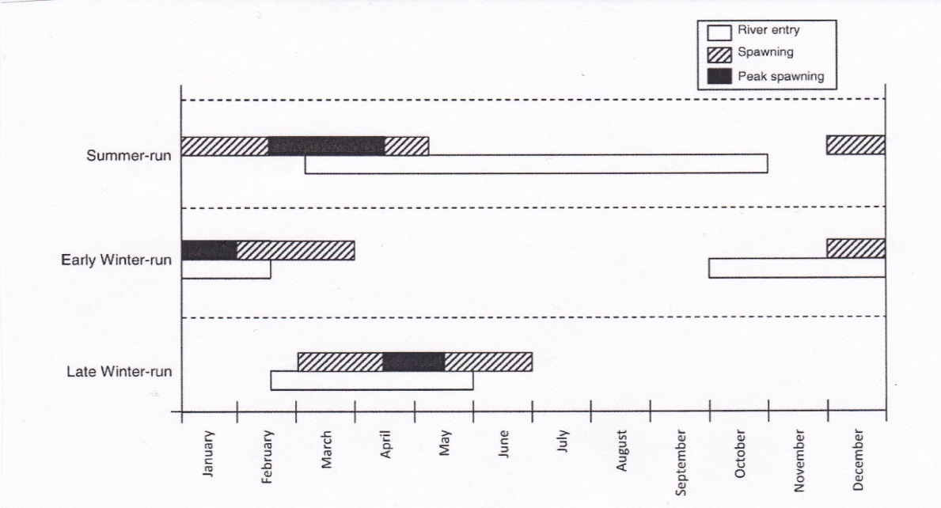
Winter-Summer Temporal Overlap
Tributary
Winters
Summers
Modest evidence for temporal
overlap in Santiam
No RT evidence in Middle Fork
Small N’s for Summer Kelts
Van Doornik et al. (TAFS 2015)
Summer
Run
Early
Winter
Run
Late
Winter
Run
Notes:
In this top figure, we have box plots showing two different behaviors
We have the timing of tributary entry for winter steelhead and the timing of tributary exit for summers steelhead
3) Looking at data from N and S Santiam Rivers, we have modest evidence for temporal overlap but we have no evidence of temporal overlap in the Middle Fork.
4) The small n’s for summer kelts limits this analysis
Intermingling might not be properly represented, so really hit that home.

Slide 23
Genetic Stock Identification (GSI)
Fin clips
180 individuals
50% winters, 50% summers
10 microsatellite loci
Analyses not complete
Results in reports

Slide 24
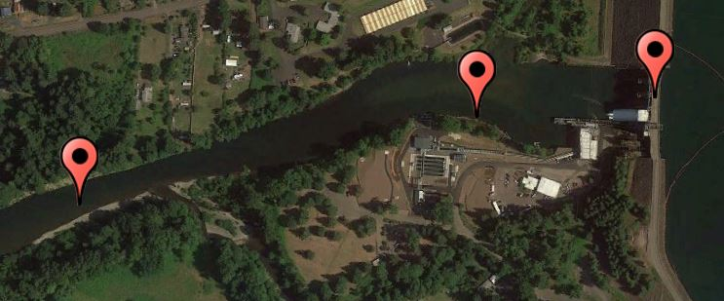
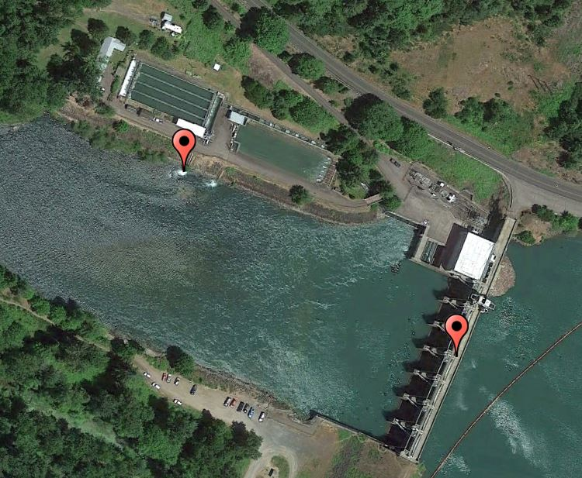
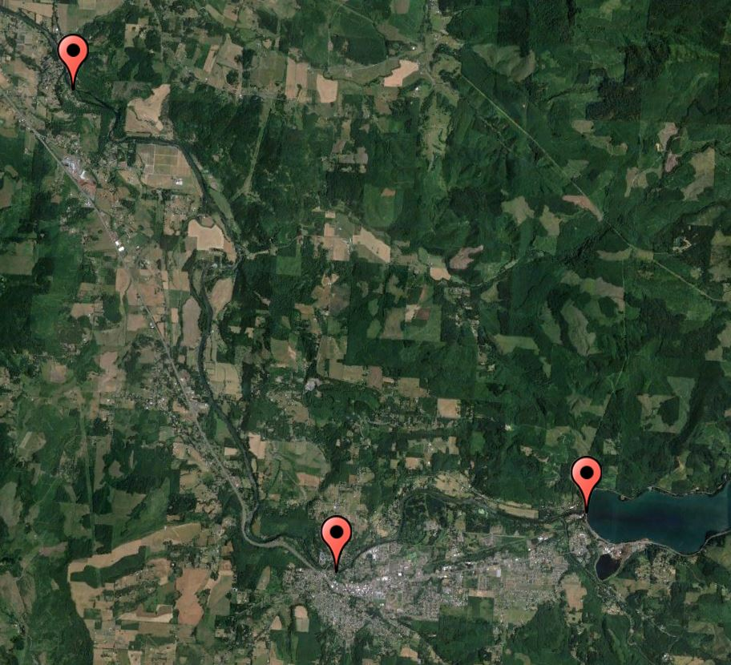
Recycled Summer Steelhead Below Foster and Dexter Dams: 2012-2014
Foster Dam
Wiley Creek release
Foster tailrace
release
South Santiam River
Waterloo County Park
release
Dexter release
Dexter Dam
Foster Dam
Middle Fork Willamette
Pleasant Valley
Boat Launch release
South Santiam River
Notes:
I am going to show a few slides with results from the steelhead recycling project that we conducted from 2012 through 2014
Summer steelhead were radio-tagged at Foster and Dexter Dams and then released downstream
Fish tagged at Dexter were released directly into the Dexter tailrace
Fish tagged at Foster were released at the county park in Waterloo and at the Pleasant Valley Road boat ramp during all years of the study
In 2013 fish were released near Wiley Creek and in 2014 fish were also released directly into the Foster tailrace

Slide 25
Fates of Recycled Summer Steelhead < Foster Dam
All years combined:
n = 3 years
9% recaptured by anglers
30% recaptured at Foster Fish Facility
Greater angler recaptures of fish released closer to Foster
~50% of recycled steelhead last detected in S. Santiam
9% exited S. Santiam
Notes:
As part of this project, we also radio-tagged summer steelhead that were recycled below both Foster and Dexter Dams
Call out colors of bars
8.8% were reported recaptured by anglers and roughly 30% were recaptured at the Foster Fish Facility
Ten percent exited the S. Santiam
In both 2013 and 2014 fish released closer to Foster were recaptured at higher rates than fish released further downstream.
Perhaps most importantly, approximately 60% of recycled fish over the course of the study remained in the system . Some most likely died, some were harvested but not reported, and some could have spawned with winter steelhead
Discuss that the concentration of angler effort is at areas of tailrace

Slide 26
Fates of Recycled Summer Steelhead < Dexter Dam
All years combined:
18% reported recaptured by anglers
Higher % of fish recycled at Dexter recaptured by anglers
~54% last detected in Mid. Fk. Willamette
26% exited the Mid. Fk. Willamette
Notes:
Radio-tagged summer steelhead were released directly into the Dexter tailrace.
18% reported recaptured by anglers, the majority of which were recaptured at the tailrace
And 26% exited the Middle Fork Willamette
More than double the reported angler recapture rate of recycled fish at Foster
Almost 80% of summer steelhead released below Dexter Dam during the course of the study remained in the system. Again there was certainly unreported harvest, some died of natural causes, but certainly some could have spawned with winter steelhead.

Slide 27
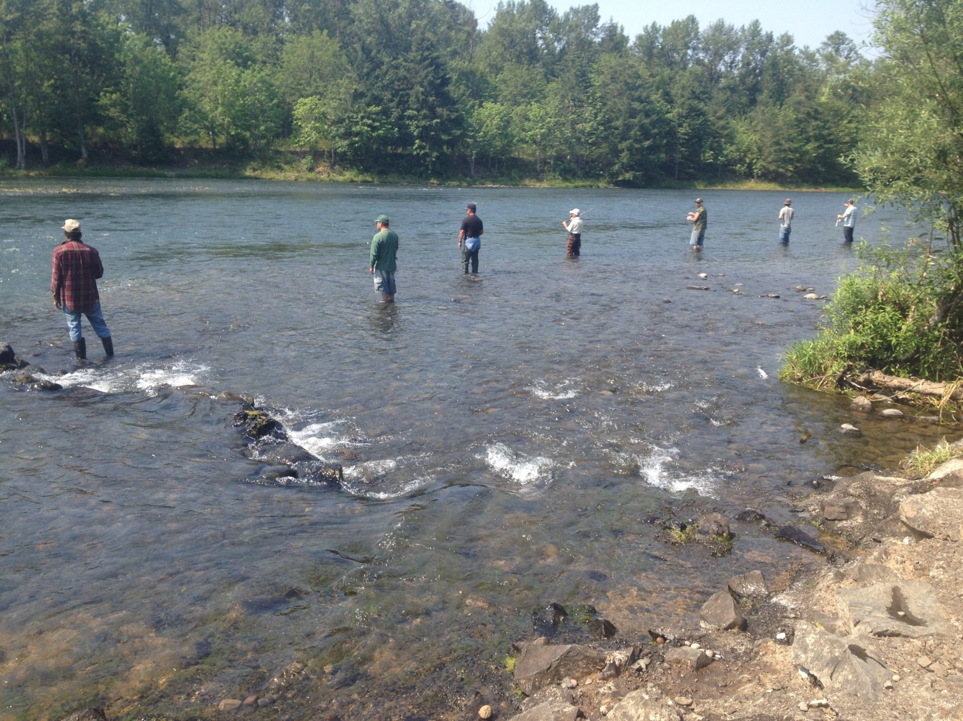
Notes:
In both systems, we had a higher percentage of recycled fish recaptured in the Dexter and Foster tailraces.
A result of the fact that there is a high concentration of fishers in these locations, as this image from the Dexter tailrace shows

Slide 28
Conclusions: Willamette Falls Tagging
Sample years captured a reasonable range of environmental conditions among years
Highest mean returns of winter steelhead to Santiam, Molalla, and M. Fork
Highest returns of summer steelhead to S. Santiam, McKenzie, and M. Fork
Winter steelhead kelting rates similar among years (58-61%)
Summer steelhead kelting rates generally low
Iteroparity rate higher in winter steelhead (~10%)
Found spatial overlap in Santiam and Middle Fork
Modest evidence for temporal overlap in Santiam – small sample sizes

Slide 29
Conclusions: Recycled Steelhead Tagging
50% of summer steelhead recycled at Foster last detected in S. Santiam
54% of fish recycled at Dexter last detected in the Mid. Fk. Willamette
26% of recycled summer steelhead below Dexter left the Mid. Fk. Willamette
Higher reported recapture of summer steelhead recycled at Dexter (18% vs. 9%)
Higher % recaptured from release sites closer to Foster Dam

Slide 30
Acknowledgments
NOAA – Kim Hatfield, Stephanie Burchfield
ODFW – Wayne Vandernaald, Kanani Bowden, Ben Clemens, Todd Alsbury, Jeff Ziller, Tony Amandi, Kelly Reis, Michele Weaver, Shivonne Nesbit, Kirk Schroeder, Elise Kelly, Dan Peck, Tim Wright, Brett Boyd, Reed Fischer, Naomi Halpern
OR Parks and Rec. Dept. – Sara Griffith
PGE – Tim Shibahara
USFWS – Bonnie Johnson, James Bowker (INAD)
USACE – David Griffith, Robert Wertheimer, Glenn Rhett, Greg Taylor, Chad Helms, Doug Garletts
UofI – George Naughton, Tami Clabough, Theresa Tillson, Grant Brink, Kal Johnson

Slide 31
Coho Salmon Tags and Counts - 2014
Notes:
I’ve included a couple of bonus slides. In the fall of 2014 we radio-tagged 219 coho at Willamette Falls. Like other areas in the Columbia Basin, it appears to have been a banner year for Coho

Slide 32
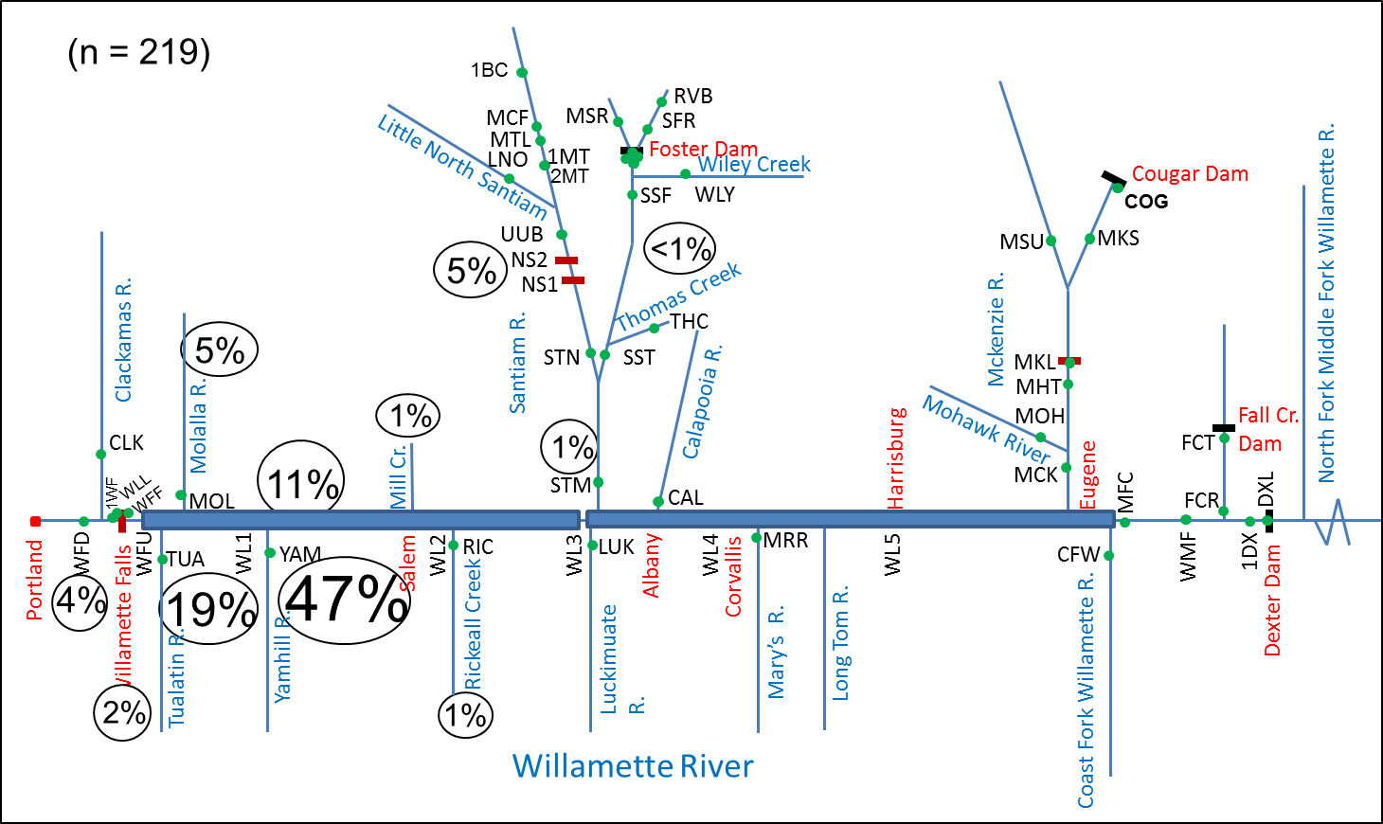
Coho Salmon Final Distribution – 2014
Notes:
This figure shows the fates of radio-tagged coho
Almost 50% of the tagged fish returned to the Yamhill River
No fish above the confluence of the Santiam River

